Slide 1

Substance Use
LAST Annual RUHS
Cost Report Training
FY 2022/2023

Slide 2

Housekeeping Rules
First:
Please mute yourselves during the presentation!
Second:
Questions should be typed into the chat box located to the right of the screen.
If you have further questions after the presentation, please submit them via e-mail to:
costreport@ruhealth.org

Slide 3

What is a Cost Report?
A Cost
Report???

Slide 4
A cost report contains provider information such as cost and charges by cost centers, Medi-Cal settlement data, and financial statement data.
The cost report settlement process is where the County reconciles the Provider’s actual cost of services to the amount of approved unit of services in comparison to what the Provider was paid by the County.

Slide 5

What is the Purpose of Cost Report Training?

Slide 6
The purpose of the Cost Report Training is to provide general instructions for completing your annual cost report. This training will also help to:
  Identify how to reconcile your unit of services submitted
  Which documents are needed to complete your cost report schedules
  To identify the required documentation that needs to be submitted to BH for review

Slide 7

Response to COVID-19:
The County intends to continue to comply with the Department of Health Care Services (DHCS) guidelines and instructions during the COVID-19 pandemic.
Please plan to submit a single cost report for the fiscal year. We will notify you if we receive anything different from the State.
  July 1, 2022 – June 30, 2023*
Please complete your cost reports based on the contract settlement as outlined in your Exhibit C of your contract.
Notes:
Made a change on this slide… please verify

Slide 8
*NOTIFICATION!!
The County has received notice from DHCS that partial FY2022/2023 units will be reimbursed per prior COVID-19 guidelines
BUT NOT TO WORRY
Please still plan to submit a single cost report and financials for the fiscal year despite your contract type.
  July 1, 2022 – May 11, 2023 – COVID-19 guidelines
  May 12, 2023 – June 30, 2023 – prior guidelines

Slide 9

So Where Do
I Begin?

Slide 10

You’ve made the 1st step by attending this (last) training!
As Per Your RUHS-BH Agreement, Exhibit C, Section J – Cost Report,
“It is mandatory that the CONTRACTOR send one representative to the COUNTY’S annual cost report training that covers the preparation of the year-end Cost Report.”

Slide 11


Gather Your Documents
Things you need to complete
your Cost Report Schedules:
      Final RUHS-BH Executed Exhibit C & Schedule I Documents
      Total Number of Unit of Services (UOS) Submitted
      Full Year Financial Statements (Preferably Audited)
      Total Payments Received from RUHS-BH

Slide 12
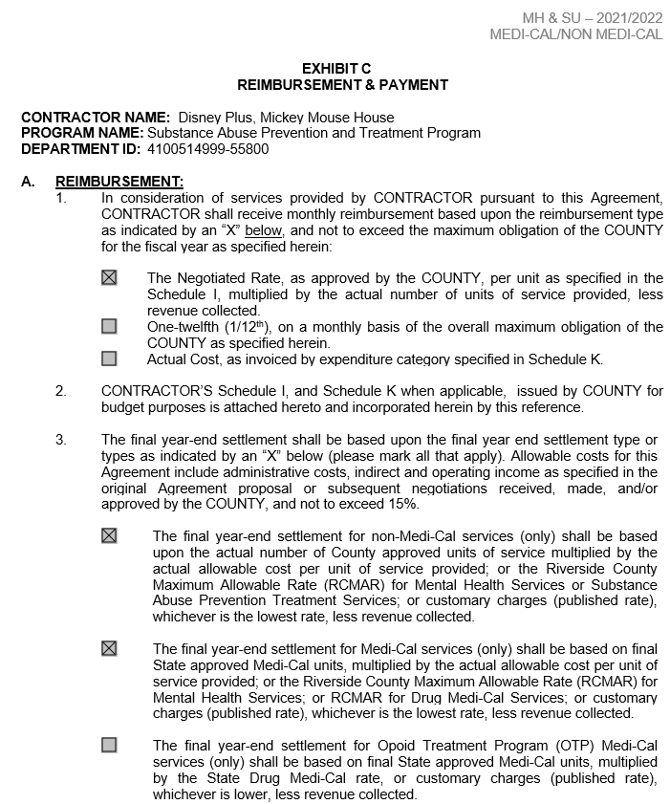
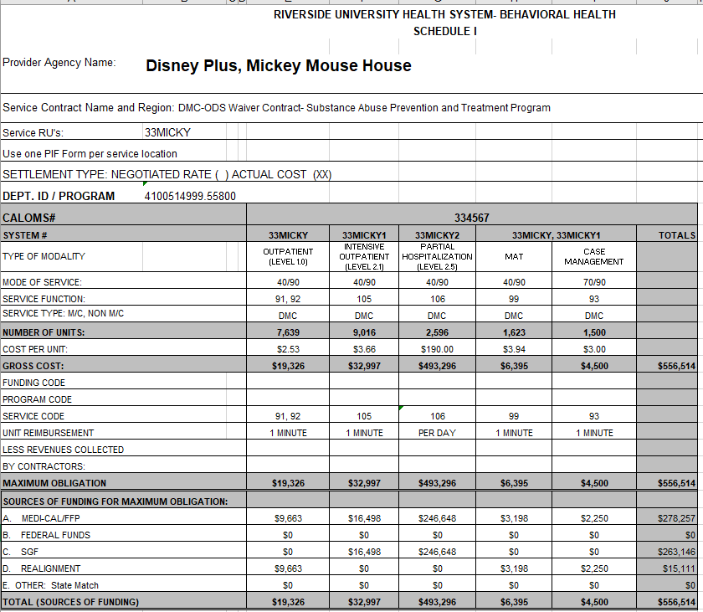
Exhibit C & Schedule I
These documents will help you fill out Schedule 1 & 5 of your cost report schedules.

Slide 13
Reconciling Your UOS
As Per Your RUHS-BH Agreement, Exhibit C, Section I – Payment:
“CONTRACTOR will be responsible for entering all service related data into the COUNTY’s MIS (i.e. Provider Connect or CalOMS) on a monthly basis and approving their services in the MIS for electronic batching (invoicing) and subsequent payment.”

Slide 14
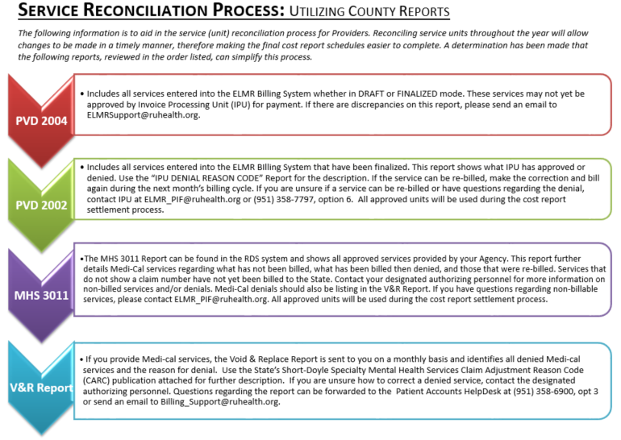

Slide 15
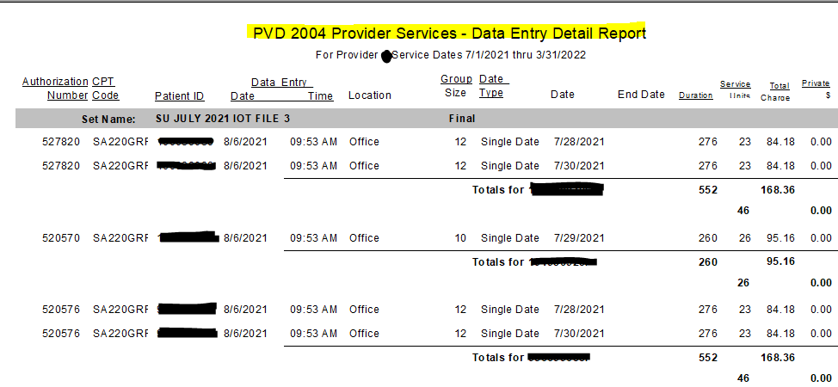
PVD 2004 Data Entry Detail Report

Slide 16
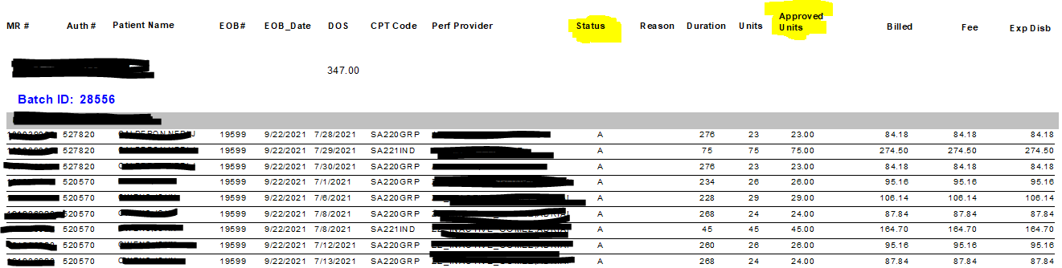
PVD 2002 Batch Service Detail
If you have any questions or concerns about the PVD 2004 or 2002 reports, please send your inquiries to ELMR_PIF@ruhealth.org.

Slide 17
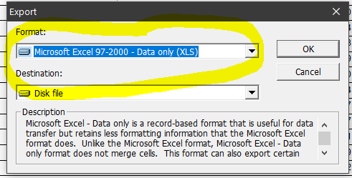
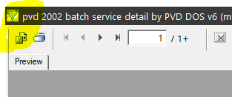
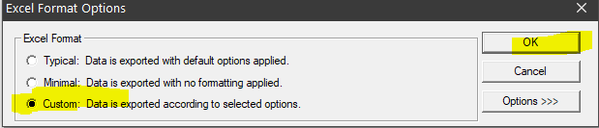
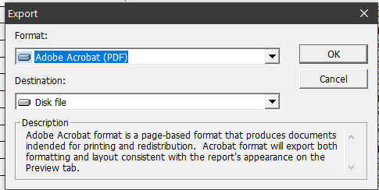
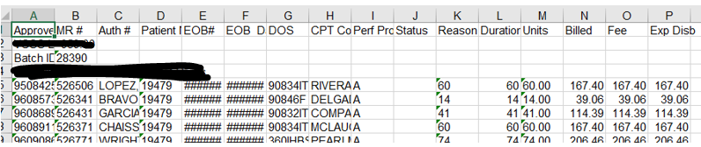
Exporting ELMR Reports
Each of these reports can be exported from ELMR into Excel by following the few prompts listed here:
3.
1.
4.
2.
5.

Slide 18
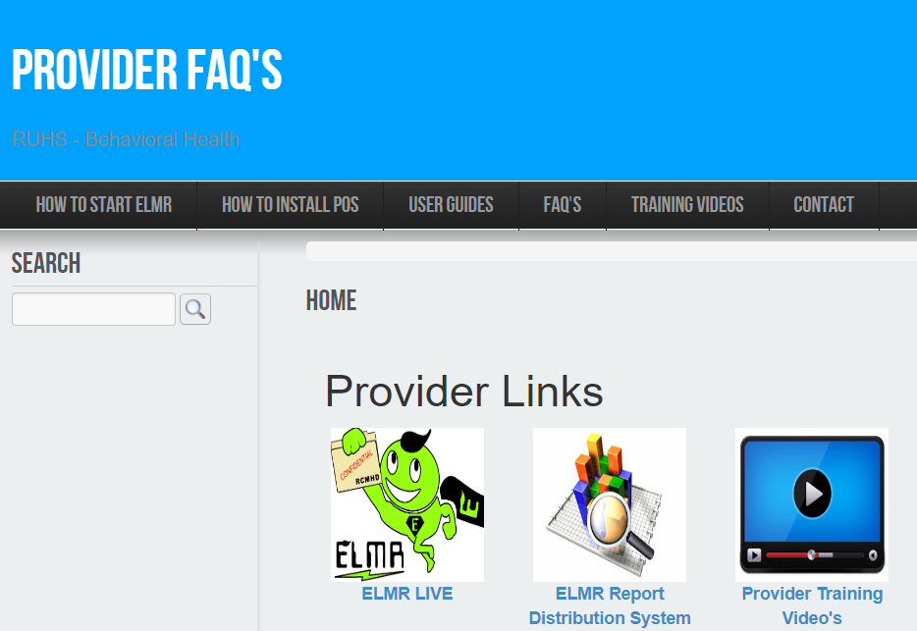
Utilize the ELMR Report Distribution System (RDS) to view your service detail reports
**Please note the County has provided Training Videos and
User Guides available for your reference!
For RDS access, please email ELMR_Support@ruhealth.org

Slide 19

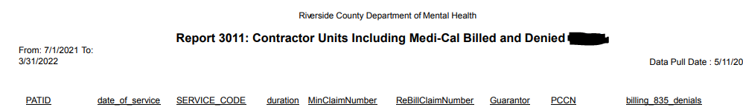





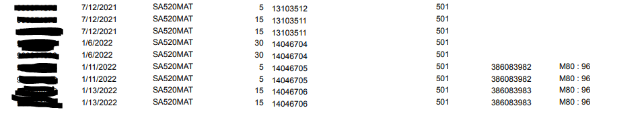
MHS 3011 Report (in RDS)

Slide 20


It is critical that you
and monitor your 3011 reports on a monthly basis!

Slide 21
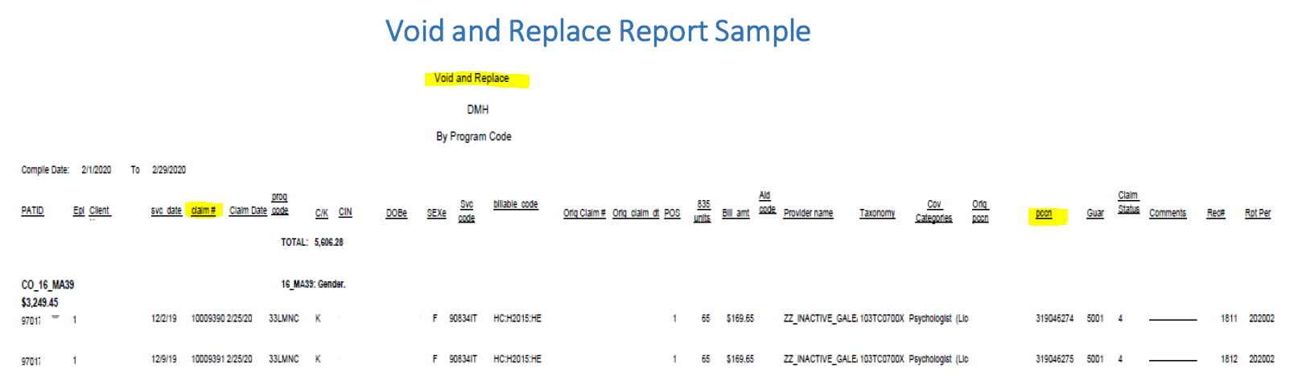
Void & Replace Report
Contractors will receive a monthly Void and Replace report, emailed from Patient Accounts. The email will include a due date, and list correctable Claim Adjustment Reason Codes (CARCs) / Remittance Advice Remark Codes (RARCs), along with instructions on how to work these denials.

Slide 22

Any services that were DENIED would have been sent out to the provider on a V&R report to allow the provider time to correct the issue before fully denying the services.
It is extremely beneficial to review this report to correct/fix any denials you may have received.
Please reach out to Patient Accounts for further assistance Billing_Support@ruhealth.org.

Slide 23

We truly hope throughout the year, that you have been working with SAPT Admin to reconcile denials you believe should be rebilled.
This will make the unit reconciliation a smoother process.

Slide 24


For those denials remaining when reconciling throughout the cost report process your assigned accountant will be providing you a list of possible rebills for which you will need to provide applicable supporting documentation in order to receive credit.
Please provide supporting documentation to SAPT Admin through the
Secure File Transfer Protocol (SFTP).
If you do not have access, please fax your documentation to SAPT Admin at 951-683-4904.

Slide 25

Financial Statements
If audited Financial Statements are not available by the date of submission, please send the un-audited Financial Statements used to prepare the Cost Report.
If your Financial Statements vary from your Cost Report figures, please submit all supporting schedules to trace numbers from Financial Statements to Cost Report forms.

Slide 26

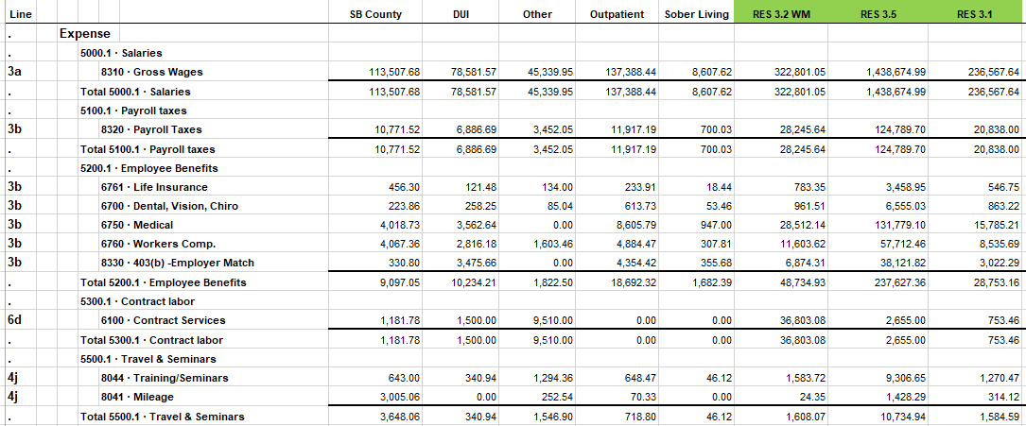
Please provide a way for the reviewer to tell what expenses & revenues were placed under each line item so the reviewer could determine if it was appropriately allocated. (Ex. 3a, 3b, 4a, etc.)
This will help save time in reviewing your financials!

Slide 27

If your fiscal year is not the same as Riverside County’s (July 1, 2022 through June 30, 2023) it is necessary to submit multiple financial statements.
EXAMPLE: On a January through December calendar year basis, submit one financial statement from July 1, 2022 through December 31, 2022 and another financial statement from January 1, 2023 through June 30, 2023.

Slide 28

Be sure to have a record of all the payments received from RUHS-BH. This information is needed for your Sch 3 & Sch 5 of your cost report schedules.
Payments Received

Slide 29

You will need to download the Cost Report Schedules and Instructions from the Department of Mental Health website:
www.rcdmh.org/Doing-Business/Provider-Connect

Slide 30
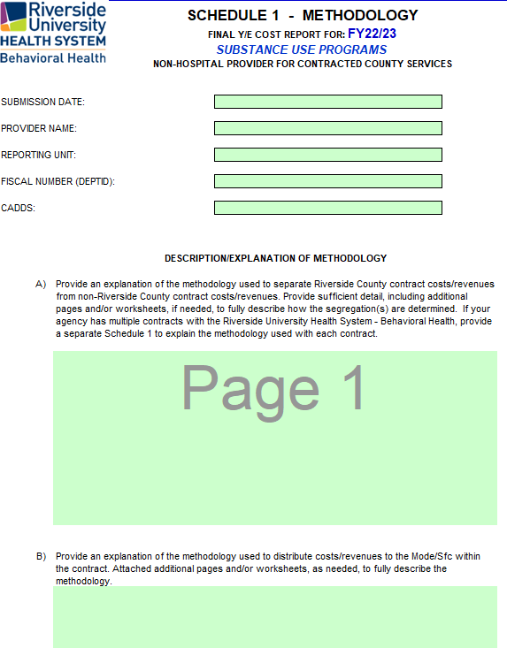
General Information on Completing the Schedules:
Complete all the appropriate information regarding your agency in the heading area of Schedule 1.
Also complete the contact information at the bottom of Schedule 5.
All figures that need to be completed by your agency are highlighted in green.
Please include cents on all dollar figures on your Cost Report. Do not round to the nearest dollar!

Slide 31
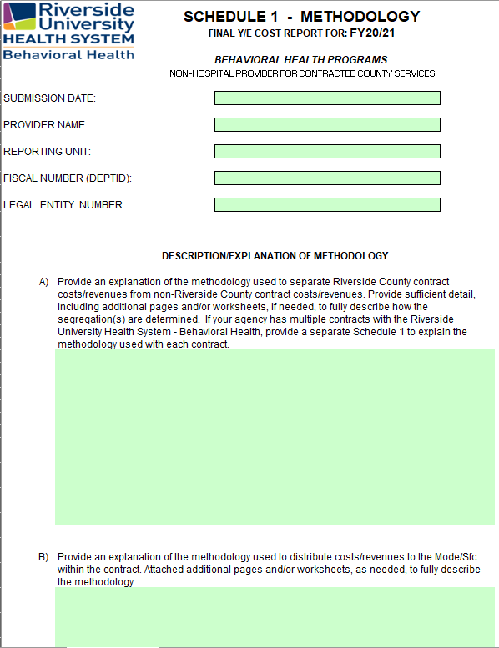
Cost Report Overview: Schedule 1
SCHEDULE 1-METHODOLOGY:
The County needs to know how your agency is breaking out expenses and revenues
Between County and your non-County programs; and
Between the various service types provided.

Slide 32

There are three (3) allocation methods which are generally used:
Direct Allocation
Unit Base Allocation
Time Study
Direct Allocation: Costs is tracked at the level of the individual program and/or service type provided.
Unit Based Allocation: Weighted average based on actual units provided multiplied by their rates.
Time Study: Weighted average based on hours worked on County services.

Slide 33

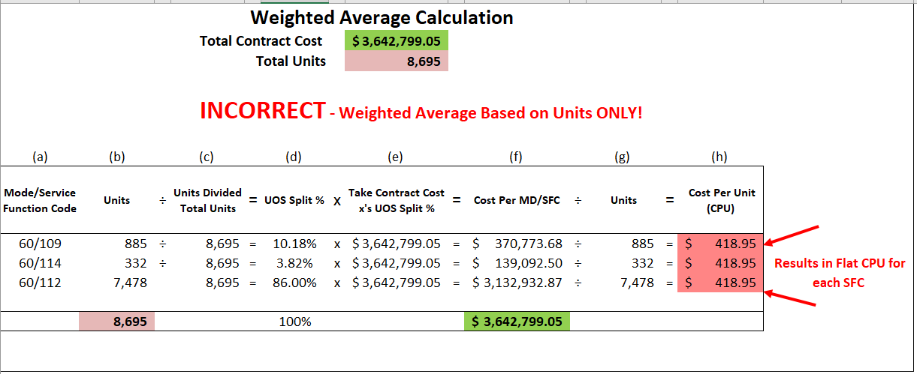
Common Mistakes of Calculating Weighted Average

Slide 34

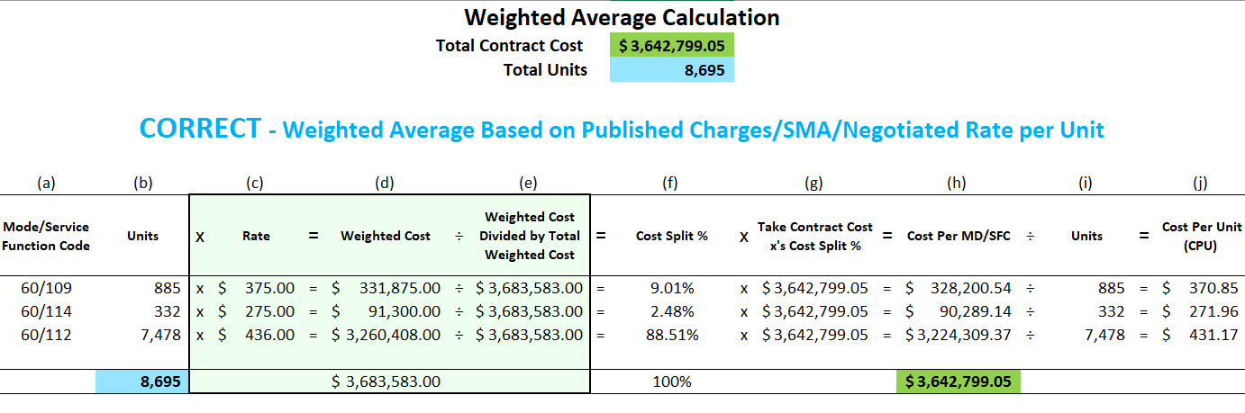
Correct Method of Calculating Weighted Average

Slide 35
Compliance Reminders
To help determine allowable and disallowable cost for cost reporting the most commonly used, but not limited to, tools are the OMB A-87 and A-122.
Federal compliance for grant recipients limits the salaries of an individual at a rate that is not in excess of the Executive Salary Level II Schedule for the reporting year. Please see https://grants.nih.gov/grants/policy/salcap_summary.htm
* Disclaimer County does have the right to determine allowable and disallowable cost.

Slide 36

Cost Report Overview: Schedule 2
SCHEDULE 2-EXPENSES:
The County will need your agency to break out the total and county expenses by the line items provided on the Schedule 2 form. Your agency will also need to allocate the expense across each service type provided based on the break-out explained in Schedule 1.

Slide 37
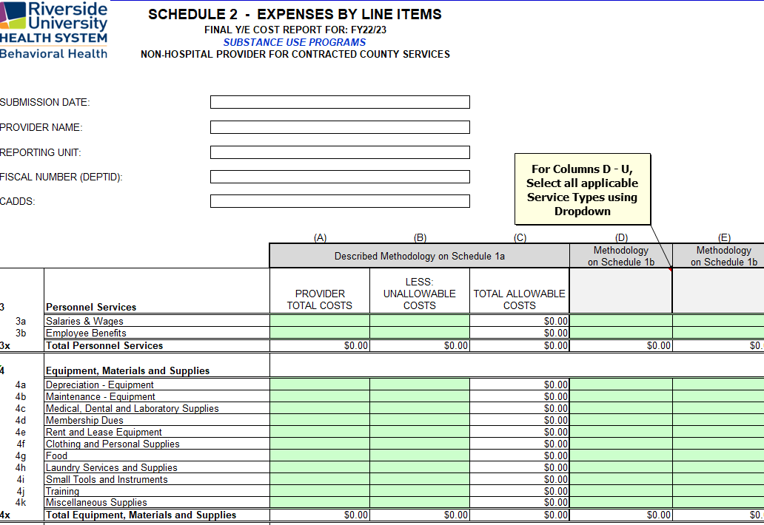
Expenses found on this form should match the expenses on the financial statements provided to the County using the methodology on Schedule 1.

Slide 38
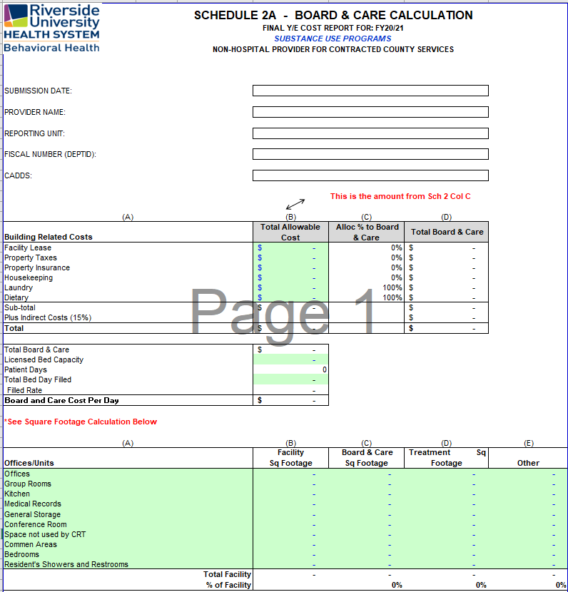

Cost Report Overview: Schedule 2A
SCHEDULE 2A-BOARD & CARE:
If applicable, the County will need your agency to break out the total and county building related expenses by the line items provided on the Schedule 2A form. Your agency will
also need to provide the total and county related square footage of your facility to determine the board and care cost per day.

Slide 39
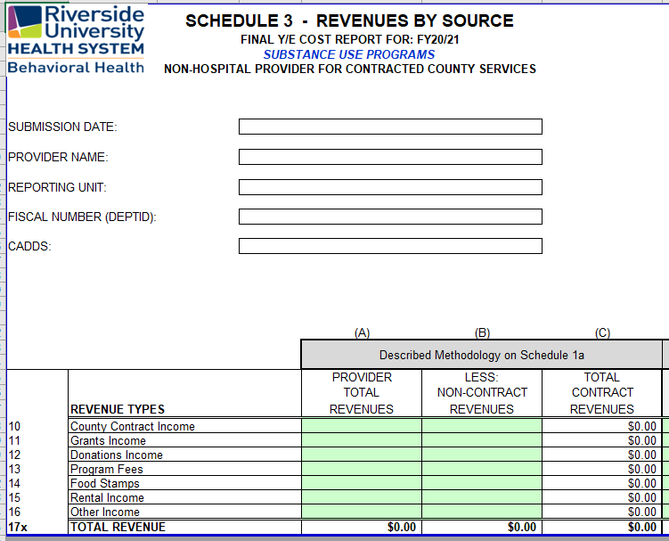
Cost Report Overview: Schedule 3
SCHEDULE 3-REVENUES:
The County will need your agency to break out the total and county revenues by the line items provided on the Schedule 3 form. Your agency will also need to allocate the revenue across each service type provided based on the break-out explained in Schedule 1.
Revenues found on this form should match the revenue on the financial statements provided to the County using the methodology on Schedule 1.

Slide 40
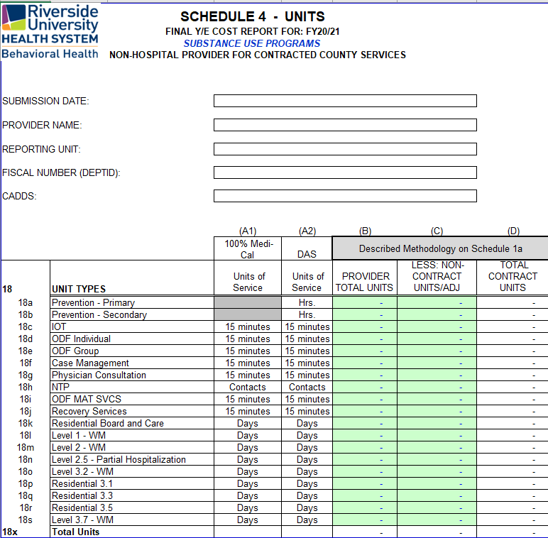

Cost Report Overview: Schedule 4
SCHEDULE 4-UNITS:
Total and County units provided by your agency should be tracked by your agency and will be required to be input on this form.
Your units entered on this form should match the unit documentation provided as well as agree with the County units on file.

Slide 41

***Remember***
You can reconcile your County Units by finding and accessing your RDS reports and/or your ELMR reports.
We will attempt to send out a preliminary unit reports soon to help aide in your reconciliation in order to identify any discrepancies ahead of time.

Slide 42

Cost Report Overview: Schedule 5
SCHEDULE 5-SUMMARY REPORT:
The Schedule 5 automatically gathers the information inputted from the other schedules to provide you with a summary report.

Slide 43
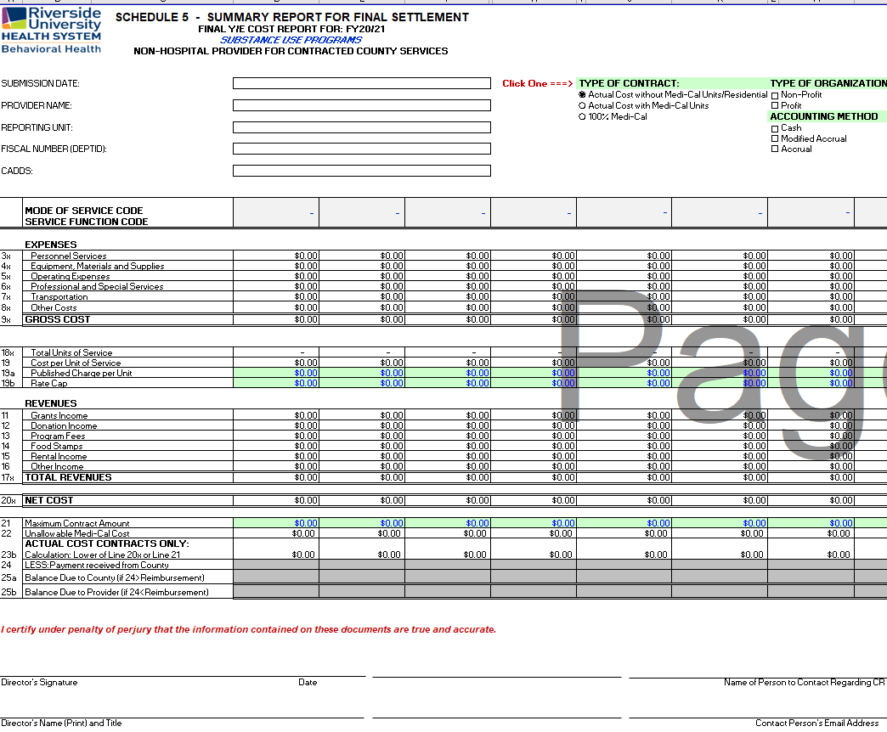
At the top of the page, you will need to select your:
Contract Type
Organization Type (profit or non-profit)
Accounting Method (cash, accrual, or modified accrual)
At the bottom of the page, please input your agency’s contact information.

Slide 44
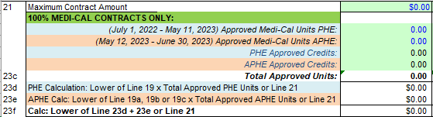
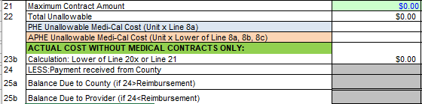
So what’s new?!
Medi-Cal Units will be divided into two periods
PHE
  Actual CPU
APHE
  Lower of:
    Actual CPU
    Published Charge
    Rate Cap
Is this extra work?
Not for you ☺
RUHS – BH Fiscal will separate Medi-Cal Units for you during the reviewing process
Two Periods:
PHE: July 1, 2022 – May 11, 2023
APHE: May 12, 2023 – June 30, 2023
Contract Type: 100% Medi-Cal
Contract Type: Actual Cost with Medi-Cal Units
*Subject to change

Slide 45
State Forms Requirements
Upon the settlement of your cost report, the County will be sending you your Final State Forms. We will need you to:
    Certify/Sign the State Form
    Return to RUHS – BH (SA)
NTP providers:
    As per BHIN-21-018, County contracted providers are now required to submit a cost report directly to DHCS.
    Before submitting, please work with your cost report accountant to ensure accuracy of information reported to DHCS.

Slide 46

How many Cost Reports do I need?
Complete a separate set of Cost Report Schedules for EACH:
Substance Use CADDS your agency has with Riverside County, as per your contract Exhibit C
Cost Reports submitted with CADDS/contracts combined are not considered properly completed and you will be contacted by your accountant for revision.
  Please be advised that some contracts may contain more than one CADDS and that one contract does not necessarily equate to one cost report.

Slide 47

Cost Report Instructions
& Samples
Navigating the Schedules

Slide 48

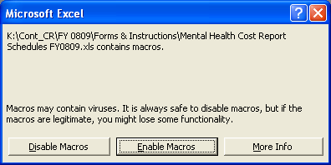
Enabling Macros:
YOU MUST “ENABLE MACROS” IN ORDER FOR THESE FORMS TO WORK!
When opening up the Cost Report Schedules in Excel versions 2003 and earlier, a pop up will ask whether to enable macros.

Slide 49

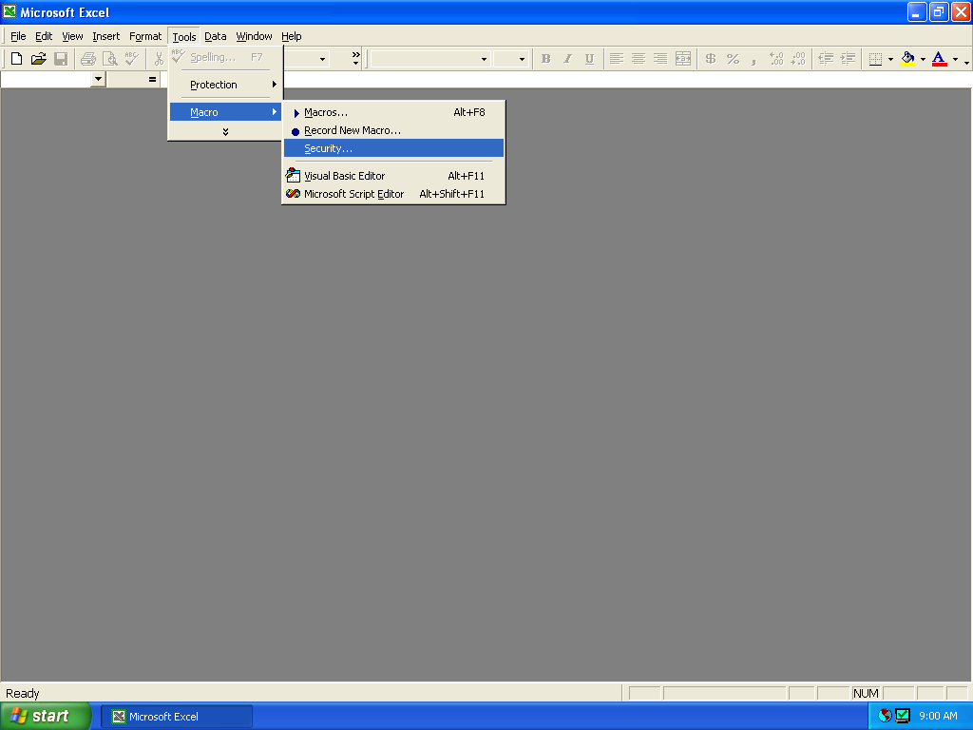
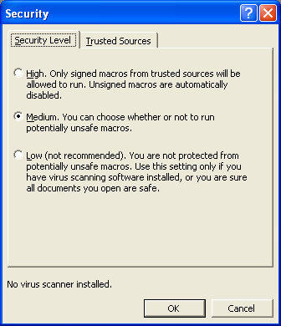
Enabling Macros (cont.):
You may also need to adjust the
Security Level in order for the Macros to run properly.
1. In Excel, select: Tools Macro Security
2. Set Security Level to Medium.

Slide 50
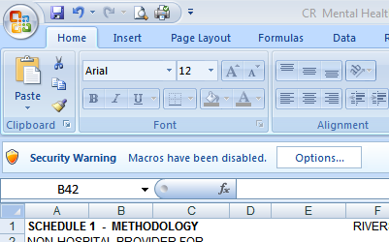
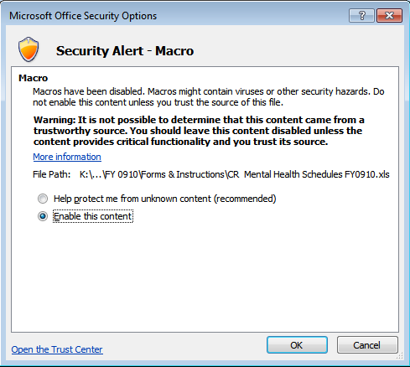
Enabling Macros (cont.):
When opening up the Cost Report Schedules in Excel 2007, you may need to change settings in order to enable macros.
In Excel, if you receive a Security Warning, Macros have been disabled, click the Options button.
2. Select Enable this content
and click OK.

Slide 51

Presenting the Cost Report Schedules

Slide 52

When are the Cost Reports Due?

Slide 53

Due Date
Substance Use
Tuesday, August 1, 2023

Slide 54

What to Submit to
RUHS – Behavioral Health
Please email to costreport@ruhealth.org:
      Electronic copy of Cost Report Schedules
      Your Financial Statements and other supporting schedules, in Excel please, that tie to the Cost Report Schedules
      A schedule of your Published Charges (the rates you charge the public)

Slide 55
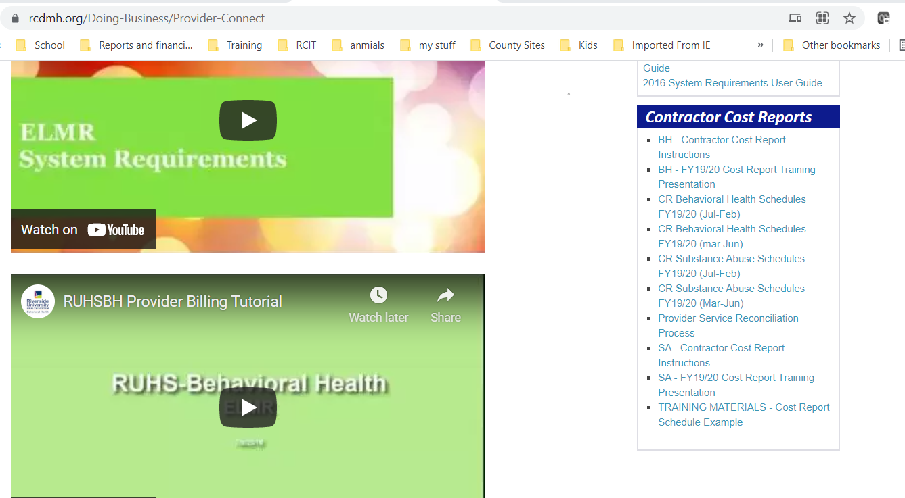
Cost Report Schedules and Instructions will be
emailed out soon and will also be available on the
Department of Mental Health website at:
www.rcdmh.org/Doing-Business/Provider-Connect
Under the Contractor Cost Reports header
on the right side of the screen.

Slide 56


Slide 57


1. How many cost reports should each contractor complete?
- One for each DeptID with associated Program codes/RU numbers.
2. What is the first thing you need to do when opening
the cost report forms?
- Enable Macros
3. What color are the cells that need to be completed?
- Green
4. What rate should a correct weighted average calculation be based on?
Published Charge, RCMAR, Drug Medi-Cal Rate, Negotiated Rate
[Md & SFC Split % = (Units x Rate) / Total Weighted Cost]
5. When entering your cost and revenues, should you include the cents?
- YES! Please do not round your figures.

Slide 58

6. Why is it important to select the correct type of contract on the top of Schedule 5?
- It will affect how the settlement is calculated
7. What are the due dates for the following cost
reports?
Substance Use
August 1, 2022
8. What do you need to submit to RUHS - BH at cost
report time?
Electronic copy of completed Cost Report Schedules
Appropriate Financials and Supporting Documentation
Published Charge Rates, if applicable

Slide 59


9. What is the correct color of ink for signatures
on the cost report?
- Blue
10. Who is responsible for signing the cost report?
- The Director, Administrator or CEO (or designee)
11. What to submit once your cost report(s) are finalized?
One (1) sign electronic copy of your Schedule 5
Signed copy of your repayment method, if applicable
One (1) signed in blue ink hard copy of the Schedule 5 mailed to:
    RUHS-BH Fiscal Analysis Unit
    PO Box 7549
    Riverside, CA 92503
Notes:
Deleted Question #10 that pertained to separate COVID reporting period

Slide 60


12. What do you do with the state forms?
- You will sign them, certify them and mail them back to RUHS – BH (SA)
13. What minimum guidance tools are most commonly used when determining allowable and disallowable cost for cost reporting?
- OMB A-87 and A-122 (these two are the most common but not limited by RUHS).
14. What is the allowable rate cap that an Executive Salary is not to exceed?
- The salary of an individual is not to exceed the rate that is outlined on the Executive Salary Schedule for the reporting year. Also known as Level II Executive Salary rate. Please see
https://grants.nih.gov/grants/policy/salcap_summary.htm
Notes:
Deleted Question #10 that pertained to separate COVID reporting period

Slide 61


If further assistance is required, please contact us at costreport@ruhealth.org to set up a meeting with our reviewers.
Presentation and training resources will be posted on our website at www.rcdmh.org/Doing-Business/Provider-Connect.

Slide 62

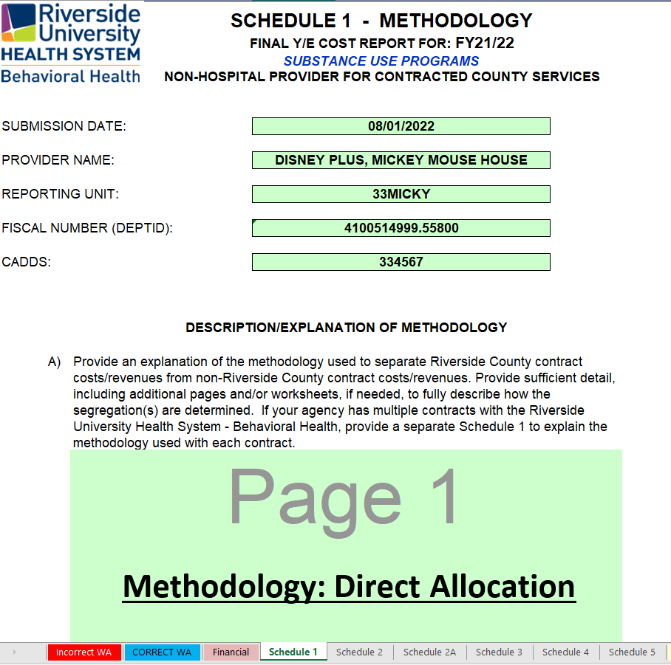
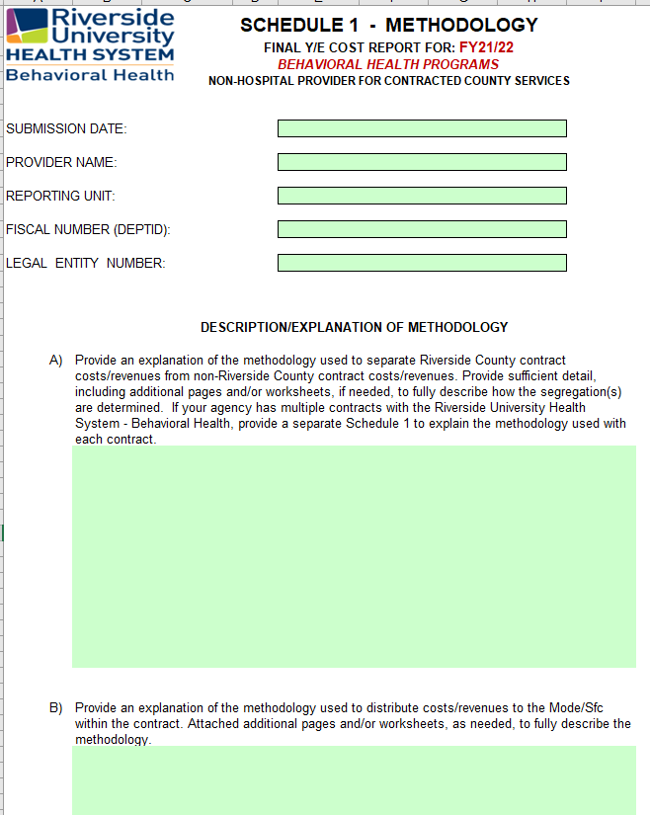
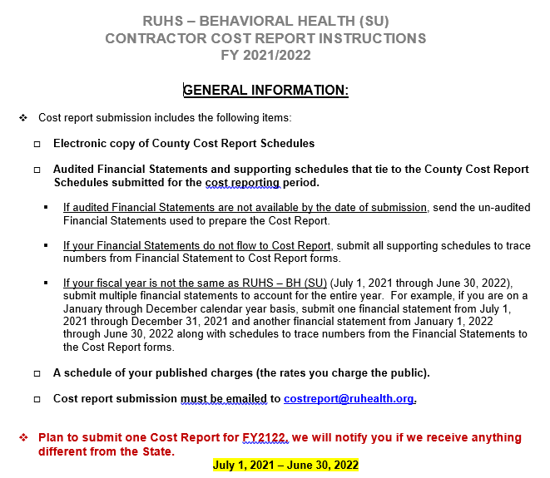
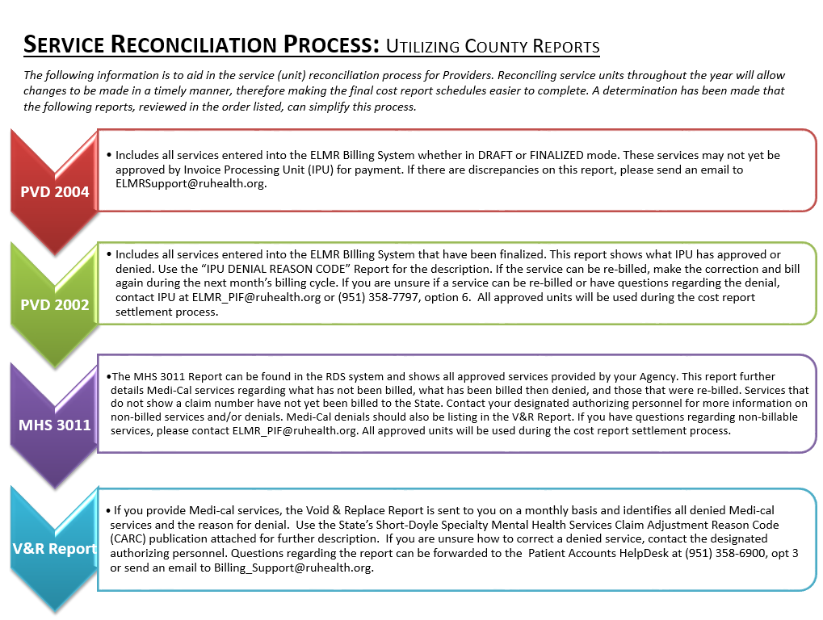

Slide 63

QUESTIONS?

Slide 64


